Slide 1

Interactive Story Publishing
Notes:
Use a simple definition of what company does (ie: ABC Company cuts costs for professional photographers through online proofing and transaction processing.)
Use plain English throughout slides & your presentation
Try to follow the 6x6 rule: no more than 6 words on a line; no more than 6 lines on a slide

Slide 2
Text Only Stories
No Video
No Animation
Contains Supportive Page and Spot Art
May Contain Supportive Sound
Uses the Keyboard for Input
Natural Language Input – You Type a Sentence, the Story Responds Intelligently

Slide 3
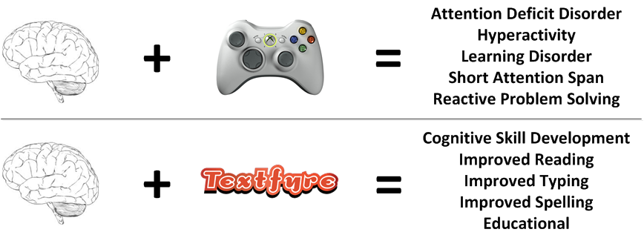
Your Brain On …

Slide 4
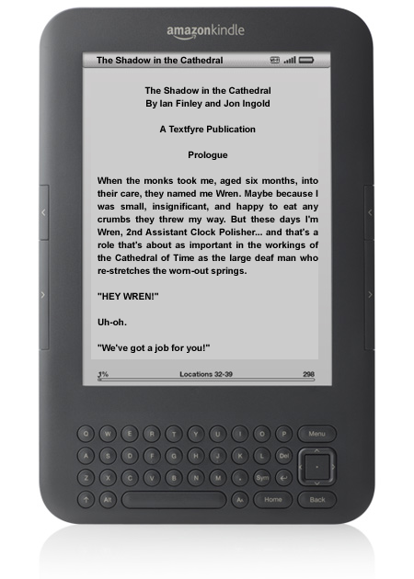

Interactive Stories Go Mobile

Slide 5
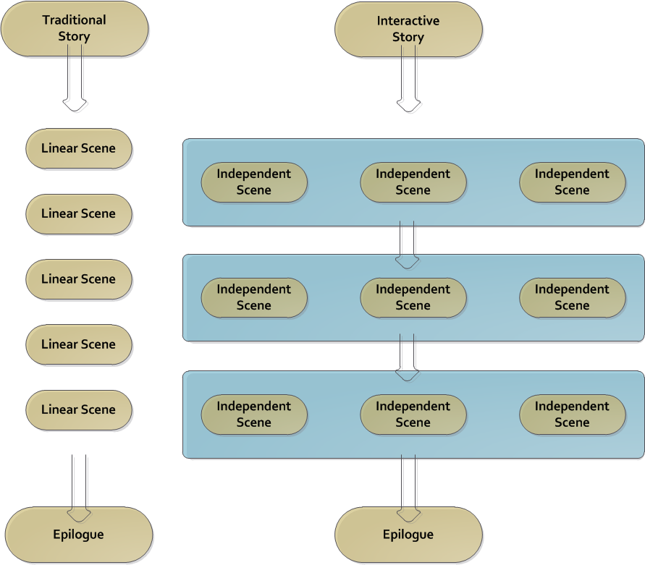
Linear vs. Interactive Story

Slide 6
Product Introduction
Text based Interactive Stories
Kindle, iPad, NookColor, eReaders
Original, Licensed, Contracted Content
Pay or Subsidized Content
Achievements sent to Facebook, Twitter, Parents, Teachers
Affordable and Healthy Digital Entertainment

Slide 7
Management Team
David Cornelson, President with over 20 years in IT
David May, Business
Jack Cummins, Legal
Paul Belanger, Finance
Notes:
Slide content:
CEO: Explain the CEO’s prior industry & entrepreneurial experience
Other C-level executives: Discuss the CMO (proven knowledge of target markets, relationships with channel partners, etc.), CTO (proven know-how in core technologies), and/or CFO (prior IPO/acquisition/exit experience)
Commitment levels: Identify who is full-time, part-time or on the sidelines awaiting funding
Board of directors/advisors: Discuss advisors and/or directors, highlighting any strategic members' value-added (prospective customer relationships, access to capital, industry expertise, etc.)
Be prepared to answer the following:
What is your background and previous experience?
Where did the idea for the company come from?
How did you get involved with the company?
Who is presently involved in managing the company?
What are their credentials?
Why will they be able to build a successful company?
If not all management spots are filled, what is the plan for filling them?
What kind of people are we seeking? To fill what roles?
If you do not expect to be the CEO that builds the business to $10 or 20 million, what kind of person would you bring in? When?
Who is on your board of directors?
How does the board function?

Slide 8
Competitive Advantage
Over 20 years of Interactive Story Experience
Mature Content Pipeline
Ability to Publish across all Devices
New Medium
Minimal Direct Competition
Approved Access to Kindle Publishing

Slide 9
Market Opportunity
Approved Kindle Publisher
Apple iPhone, iPad
Android
Windows Phone 7
Mobile Reading is Skyrocketing
  eBooks sales have tripled in last year
Interactive Reading is New Medium
  New outlet for existing content
Notes:
Slide content:
Market need/pain: explain the problem that target market is experiencing
Market characteristics: describe market, using demographics/psychographics
Market size & growth rate: quantify the market potential based on the characteristics above
Market drivers: explain why market is growing
Be prepared to answer the following questions from investors:
What specific problem or need do customers have?
Why is the problem important?
For whom? That is, who, specifically is the customer?
How do we know the market exists? What independent evidence can you cite, such as independent market research?
How large is the specific (narrowly defined) market for our product?
What growth is expected in this market?
Are the market size estimates realistic?
For industrial products…
What 2-3 industries comprise the most important prospects
What are the job titles of the buyers (decision-makers) in these prospects?
For consumer products…
What are the demographics of the 2-3 most important customer segments in Year-1? Year-3?

Slide 10
Target Market
Readers, Parents, Educators
eReader and mobile device owners
  Kindle, Nook
  iPad and other Tablets
  iPhone, Android phones, WP7 phones
PC and Mac owners

Slide 11
Marketing Plan
Nationwide PR News Release of new Platform, Partnerships, and Initial Publications
New Web 2.0 Website with Interactive Content Portal
Select Market Advertising to Reach Readers (NY Times, Washington Post, Wall Street Journal, Amazon.Com)

Slide 12
Development Timeline
PC and Mac – 100% complete
Mobile Platform complete in 2011
2 Published Products, 10 in development

Slide 13
Business Strategy
Sell/Deliver via Kindle, Mobile Marketplaces, Social Networks
Offer “all device” platform for content developers
Sell product or offer PR service
Work with existing authors
License existing material
Notes:
Slide content:
Summarize the key points that will interest potential investors:
“What we do”: the one-sentence description of company
Market opportunity: evidence of growing market demand
Management team: why your team can make this happen
Projected financials: the financial potential of the firm
Exit strategy: how investors will get their money back
Contact info: name, phone, email

Slide 14
Capital Requirements
$250,000 to start
Additional $750,000 over 12 months

Slide 15
Financial Projections
Textfyre
Profit and Loss Statement
2011-2015
 |  | 2011 | 2012 | 2013 | 2014 | 2015
Total Revenue |  | 2,786,000 | 5,253,600 | 8,358,000 | 11,462,400 | 12,035,520
Total COGS |  | 696,500 | 1,313,400 | 2,089,500 | 2,865,600 | 3,008,880
Gross Profit |  | 2,089,500 | 3,940,200 | 6,268,500 | 8,596,800 | 9,026,640
 |  | 75% | 75% | 75% | 75% | 75%
Operating Expenses
Selling |  | 944,800 | 1,687,320 | 2,621,977 | 3,556,735 | 3,732,211
General and Admin |  | 1,492,200 | 1,536,966 | 1,583,075 | 1,630,567 | 1,679,484
Total Operating Expenses |  | 2,437,000 | 3,224,286 | 4,205,052 | 5,187,302 | 5,411,695
EBITDA |  | (347,500) | 715,914 | 2,063,448 | 3,409,498 | 3,614,945
Other Income and Expense |  | 51,500 | 51,500 | 29,000 | 29,000 | 29,000
Net Income/(Loss) |  | (399,000) | 664,414 | 2,034,448 | 3,380,498 | 3,585,945

Slide 16
Exit Strategy
Three years to build pipeline of content
Sell when valuation exceeds $25,000,000

